Slide 1



Trial for Long-term Preservation and Utilization of Data in Asia
In Towards Data Sharing, Integration, and Multiproxy Collaboration in Historical Studies: New Insights and Future Challenges in Japan
Shoichiro HARA: Kyoto University, Japan
Akihiro KAMEDA: National Museum of Japanese History, Japan
Shigeo SUGIMOTO: University of Tsukuba, Japan
Notes:
This presentation／ “Trial for Long-term Preservation ／ and Utilization of Data in Asia,” ／ is given by 3 speakers.

Slide 2
Structure of the Presentation
Background and aims of our activity (Shoichiro HARA)
Research small Data Alliance in East and Southeast Asia
Background
Aims of RsDA
Current development
Inventory Database (Akihiro KAMEDA)
Data model and metadata
Example(s)
Search interface
Summary (Shigeo SUGIMOTO)
Notes:
Shoichiro Hara (myself) will present the background／ purpose／ and overview of our activity.
Akihiro KAMEDA will explain our database ／ mainly for data model ／ and metadata.
And finally, Shigeo SUGIMOTO will summarize the presentation ／ with mention of our future challenges.

Slide 3
Research small Data Alliance in East and Southeast Asia (RsDA)
What: An international collaborative activity to collect, preserve and use research data assets in the humanities in East and Southeast Asian countries
Why: Importance of managing academic data assets in the region for the future
Who: Hosted by Center for Southeast Area Studies (CSEAS), Kyoto University and many international collaborators mainly of university institutions, libraries, museums, and archives
How: Sharing knowledge about academic data assets and building a database of the assets by collaboration among researchers, librarians and archivists in the region
Notes:
Our project is named ／ Research small Data Alliance in East and Southeast Asia ／ (RsDA).
RsDA is an international collaborative project ／ to collect,／ preserve,／ and use／ research data assets ／／ in the humanities in East and Southeast Asian countries.
This project is important ／ to manage academic data assets ／ in the region for the future.
And this project is hosted by ／ the Center for Southeast Asian Studies (CSEAS), Kyoto University／ with many international collaborators ／ mainly of university institutions, ／ libraries,／ museums,／ and archives／／ by sharing knowledge ／ about academic data assets ／／ and building a database of the assets ／ by collaboration ／ among researchers, librarians, and archivists in the region.

Slide 4
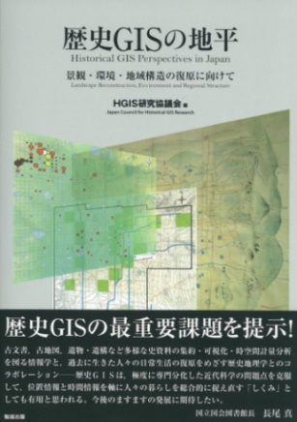
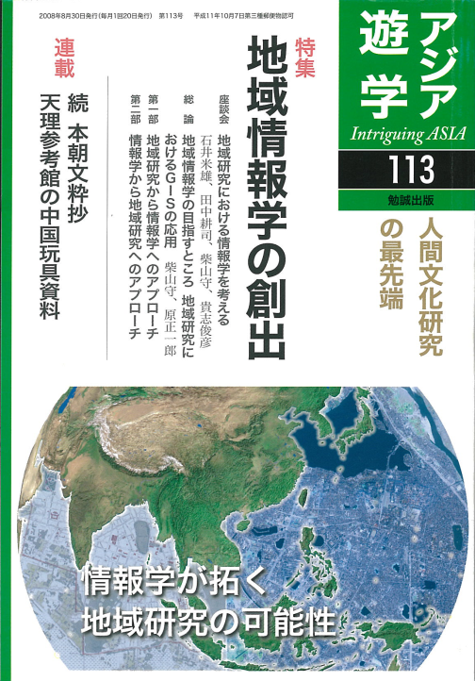
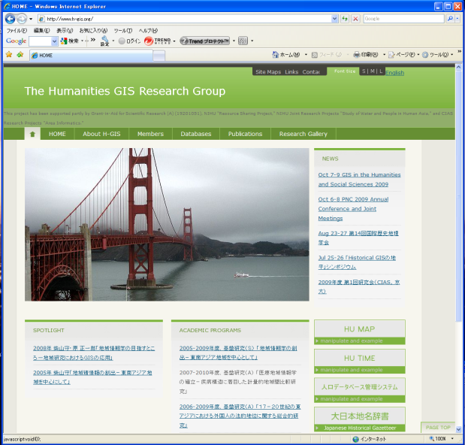
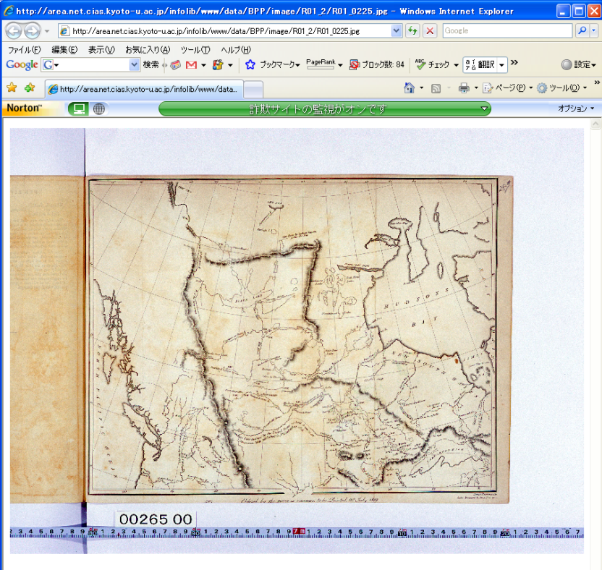
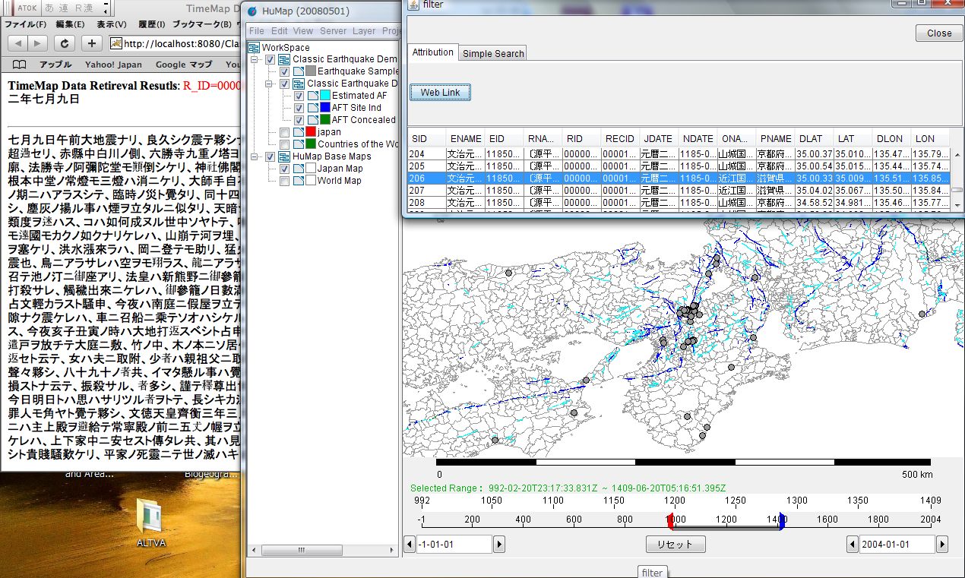
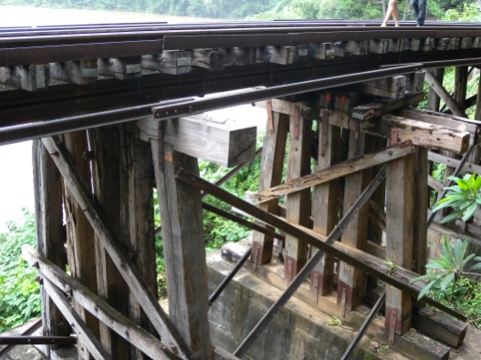
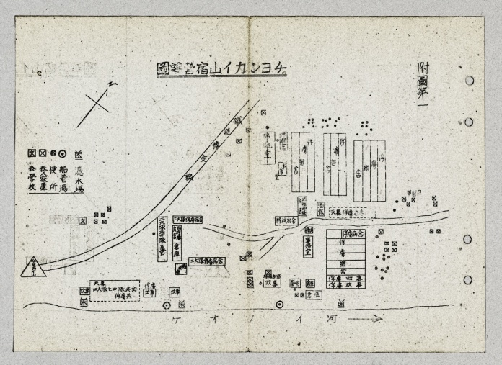
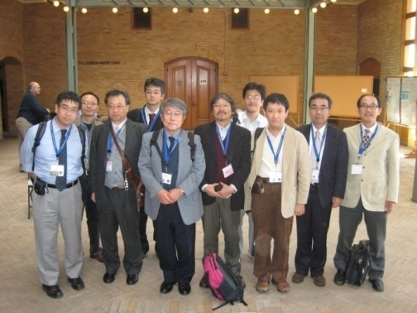
Background of RsDA
- CSEAS and Areainformatics -
CSEAS: Center for Southeast Asian Studies, Kyoto University
The largest area studies institute for Southeast Asian in Japan
One of the world’s leading research institutes for Southeast Asian Studies
CSEAS’s Areainformatics aims to
create new paradigm in area studies by applying
advanced information technologies
construct information platform to support for
Preserving research assets
Publishing data
Sharing data
Using data
Notes:
CSEAS, ／ Kyoto University ／／ is the largest institute for Southeast Asian studies in Japan ／ and one of the world's leading research institute.
CSEAS has been creating ／ a new paradigm in area studies ／ by applying advanced information technologies.
We call it “Areainformatics” ／／ and have constructed an information platform ／ to promote／ preserving, ／ publishing, ／ sharing, ／ and using data.
The areainformatics ／ at CSEAS ／ has created ／ databases and services,／ and they are well recognized in Japan.
Then, we started international collaboration／ to share research data assets.
RsDA is one of its trials.

Slide 5
Aims of RsDA
RsDA is an international collaborative activity to share local needs and seeds for digital archiving and preservation of scholarly assets and to discuss ideas to develop a network to promote collaboration in the region. The main aims of the workshop are to:
understand and share the current circumstances about academic digital assets in the leading East and Southeast Asian academic institutes and memory institutions
provide opportunities for the members to exchange and share thoughts, views and ideas about how we should deal with resource sharing and digital asset preservation, what kind of technology will be available, and who should be contributors to this issue
discuss practical approaches to build a network for collaboration rather than presentation of papers
develop information tools to try or evaluate discussions
Notes:
RsDA is an international collaborative activity ／ to share local needs and seeds ／／ for digital archiving ／ and preservation of scholarly assets, ／／ and to discuss ideas ／ to develop a human network,／ and to promote collaboration in the region.
The main aims of RsDA are:
To understand and share the current circumstances ／ about academic digital assets ／ of academic institutes and memory institutions ／ in East and Southeast Asia.
To provide opportunities for the members ／／ to exchange and share thoughts, ／ views and ideas ／ about ／ how we should deal with resource sharing. ／ and digital asset preservation,／／ what kind of technology will be available, ／／ and who should be contributors to this issue
To discuss practical approaches ／ to build a network for collaboration ／ rather than presentation of papers
To develop information tools ／ to try or evaluate discussions

Slide 6
Members of RsDA
Member Institutes:
Academia Sinica (Taiwan), Chiang Mai University (Thailand),
Chulalongkorn University (Thailand),
International Research Center for Japanese Studies (Japan),
Khon Kaen University (Thailand),
National Museum of Japanese History (Japan),
National Taiwan Normal University (Taiwan),
National University of Singapore (Singapore),
Royal University of Phnom Penh (Cambodia),
Suranaree University of Technology (Thailand),
Universitas Indonesia (Indonesia),
Universitas Islam Riau (Indonesia),
Universitas Lancang Kuning (Indonesia),
Universiti Teknologi MARA (Malaysia), University of Colombo (Sri Lanka),
University of the Philippines Diliman (Philippines), University of Tsukuba (Japan), Kyoto University (Japan)
Notes:
This slide shows the RsDA members.
Currently, 18 research institutes, university libraries, museums, and archives from 9 countries.
We had some experiences in collaborative activities. For example, I have collaborated ／ to create “Palm Leaves Manuscript Database” with Thai colleagues.

Slide 7
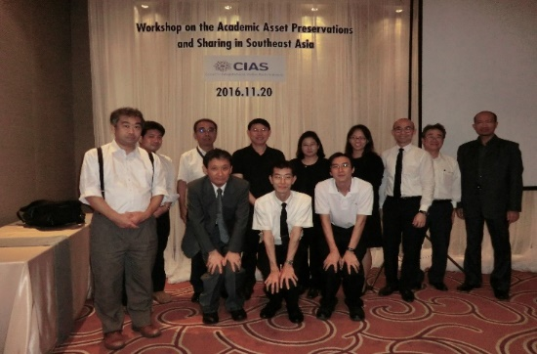
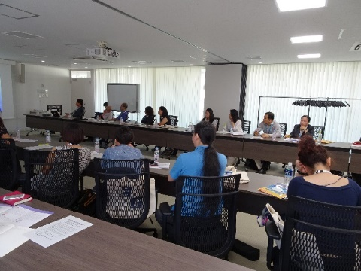
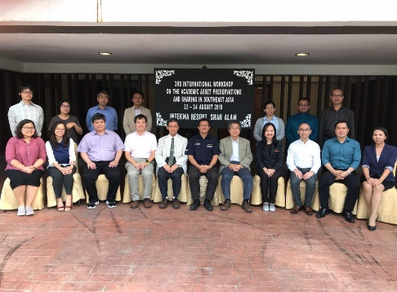
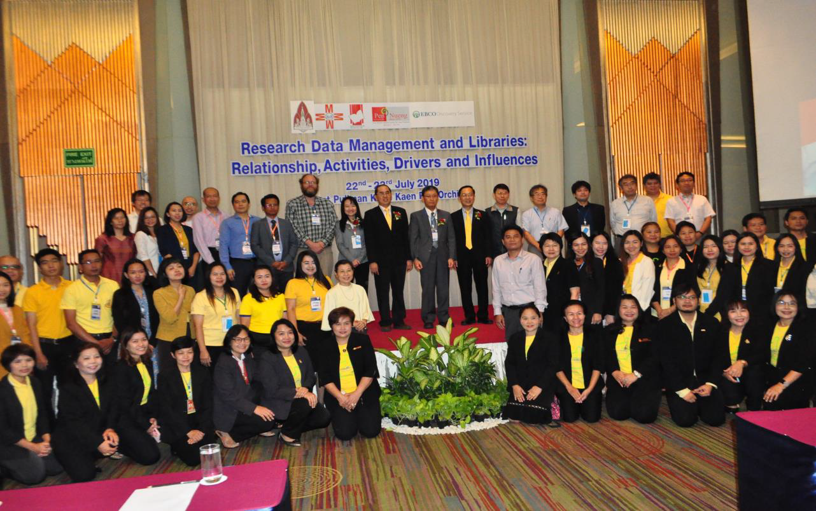
Activities of RsDA
1st meeting: 2016-11-20@Pullman Bangkok Grande Sukhumvit (Thailand)
“International Workshop on Academic Asset Preservation and Sharing in Southeast Asia” as a preliminary workshop for iPRES2017 hosted by Kyoto University
2nd meeting: 2017-09-25@Kyoto University (Japan)
“International Workshop on Academic Asset Preservations and Sharing in Southeast Asia” with iPRES2017 hosted by Kyoto university
3rd meeting: 2018-08-23 and 24@INTEKMA Resort & Convention Center
“International Workshop on the Academic Asset Preservations and Sharing in Southeast Asia” hosted by Universiti Teknologi Mara
4th meeting: 2019-0-23 and 24@Pullman Khon Kaen Raja Orchid Hotel (Thailand)
“International Workshop on Academic Asset Preservation and Sharing in Southeast Asia” with “Research Data Management and Libraries: Relationship, Activities, Drivers and Influences” hosted by Khon Kaen University
5th meeting: 2020-08-25 by ZOOM
Notes:
We have organized international workshop 5 times.
The kick-Off workshop was in 2016 in Bangkok.
The second meeting was in 2017 ／ as a part of International Conference on Digital Preservation (iPRES) 2017 at Kyoto University.
After iPRES2017, RsDA workshops were held annually ／ hosted by member institutes.

Slide 8
Current Development by RsDA
- Finding Aid of Academic Research Assets -
Inventory
Database
Web Interface
Information Aggregation from Web Pages
Web (View Level)
Database
GUI/ Home Page
Database
GUI/ Home Page
Home Page
Database
Home Page
Access Points
from Inventory Database
Database
Home Page
Database
Home Page
Servers Level
Digital Data
MyDatabase
Library
System
Data Base
MyDatabase
MyDatabase
Database
Target Digital Assets of the Inventory Database
Notes:
Through discussions／, we realized some overlapping efforts among participants／, such as very similar databases.
We also agreed ／ that ／ we don’t know ／ what kind of digital assets we have.
In the workshops, we agree ／ to develop “Inventory Database,” as a tool ／ to find and share digital research assets.
This slide shows the overview of our Inventory Database.
Member institutes create digitize assets ／ and publish them through library systems, institution’s databases, or homepages.
CSEAS offers MyDatabase ／ for individual researchers ／ to facilitate data publications.
The Inventory Database is a collection of metadata ／ to help users access digital assets.

Slide 9

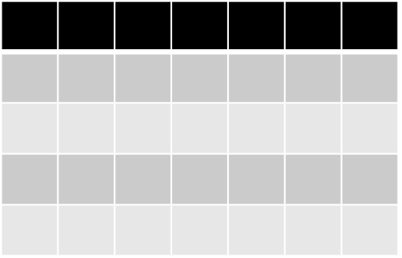



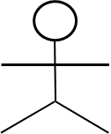
Overview of Inventory Database
Develop
& Maintain
Catalogue
Website
Research Data
Database
Research Data
RsDA members
Website
Web interface
Database
Inventory
Database
Create
& Maintain
Develop
& Maintain
Retrieve
& Use
Librarian/Archivist
Researcher
User
Notes:
I’m Akihiro Kameda, I will explain the inventory database.
To build our inventory database, we collected information from each database. In many cases, research data databases are hosted by institutions such as universities or libraries, where librarians or archivists develop the system and maintain them. Those research data databases may be created by institutes or individual researchers.
We listed up candidate websites first.

Slide 10
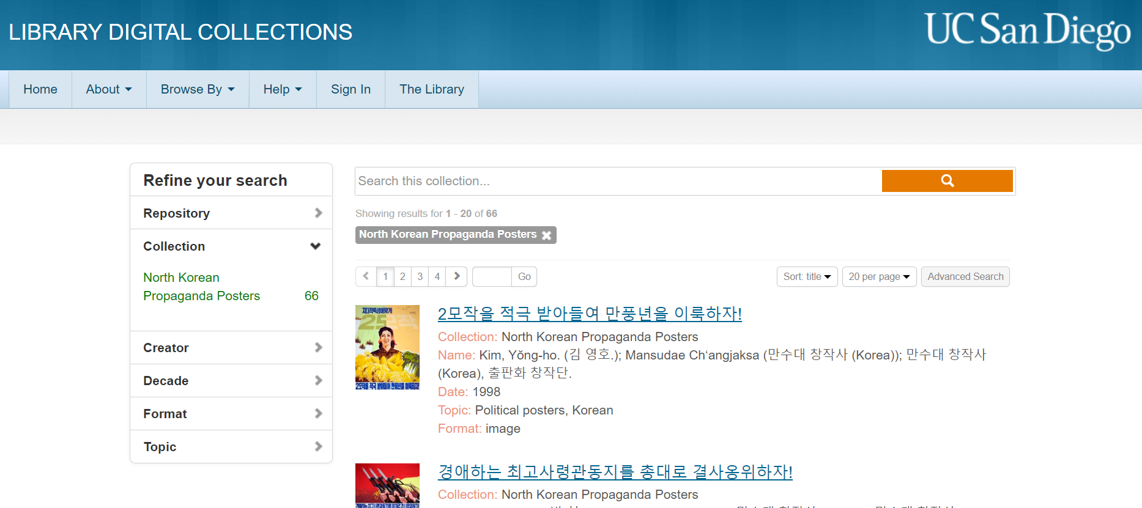
Example Website of a Dataset (1)
Search window
Listed items in the dataset
Notes:
This is an example of a dataset website. You can imagine so-called digital libraries or digital collections as the target of our catalogue.

Slide 11
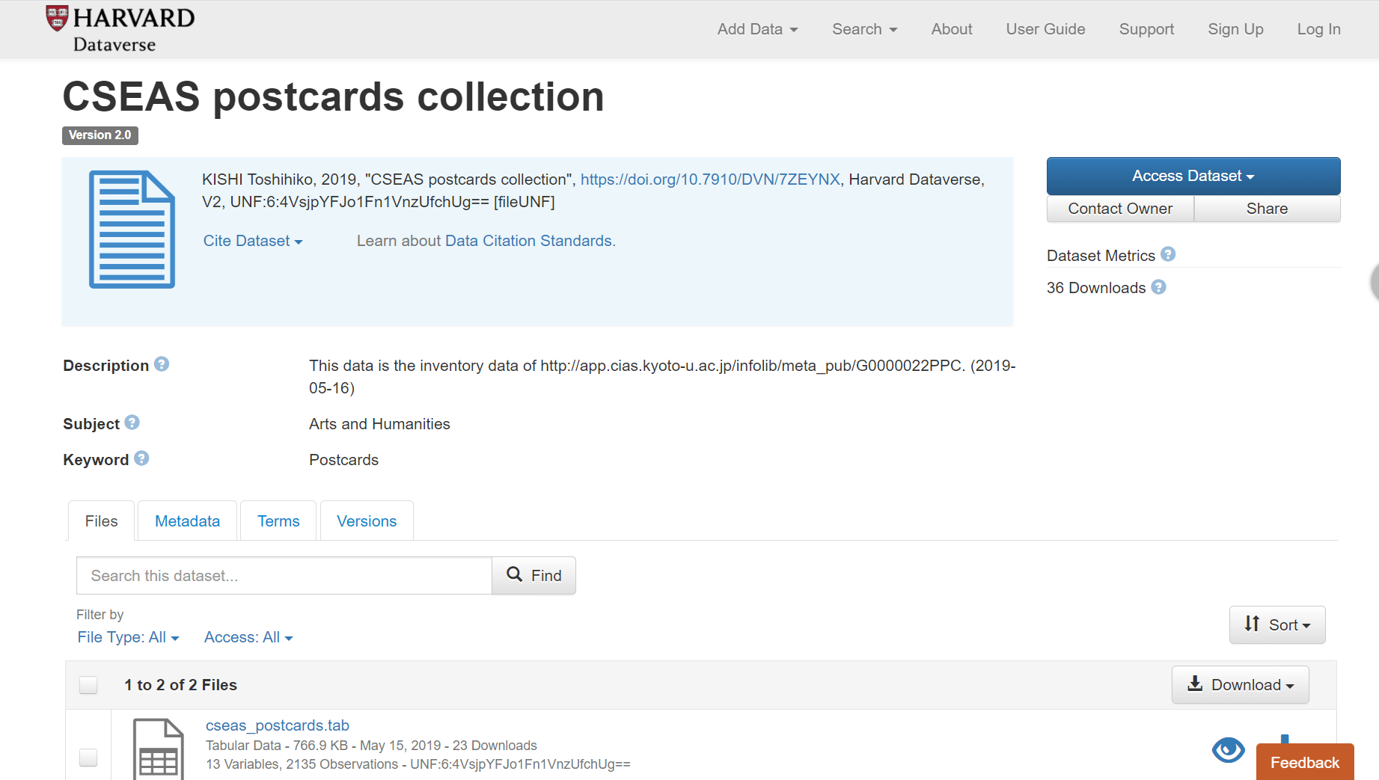
Example Website of a Dataset (2)
Research data dataset
in a data repository
List of Downloadble files
Notes:
Recently, it becomes common to share research data in data repositories such as Figshare or Dataverse instances. Both types of the dataset, shown in the previous and this slide, are in our scope of cataloguing.

Slide 12
Overview of Inventory Database
Develop
& Maintain
Catalogue
Website
Research Data
Database
Research Data
RsDA members
Website
Web interface
Database
Inventory
Database
Create
& Maintain
Develop
& Maintain
Retrieve
& Use
Librarian/Archivist
Researcher
User
Notes:
Based on the investigation of examples,

Slide 13
Overview of Inventory Database
Website
Database
Website
Web interface
Database
Inventory
Database
Notes:
we started to design a metadata model as a foundation of the Inventory Database.

Slide 14
Metadata Model
Dataset
describes
Inventory Entry
Notes:
We have tried to design this model as simple as possible.
However, in reality, the datasets were so diverse.
##
For example, we found a dataset composed of collection of postcard images, a collection of geographical names, collection of descriptions of palm leaves, and so on.
Therefore, we modeled the components of datasets into Source Object and its description, which is called data in the slide.
# which may be research data databases or data repositories
This model is designed to help users find and access the datasets.
So,
To catalogue each research data database, we model what we should describe.
Each inventory entry describes the Dataset mainly. We don’t require search function of databases, in other words, static files on a data repository are also our targets of cataloguing. Therefore, here, we call it Dataset instead of Database. In the following slides, we focus on two features of this data model.

Slide 15
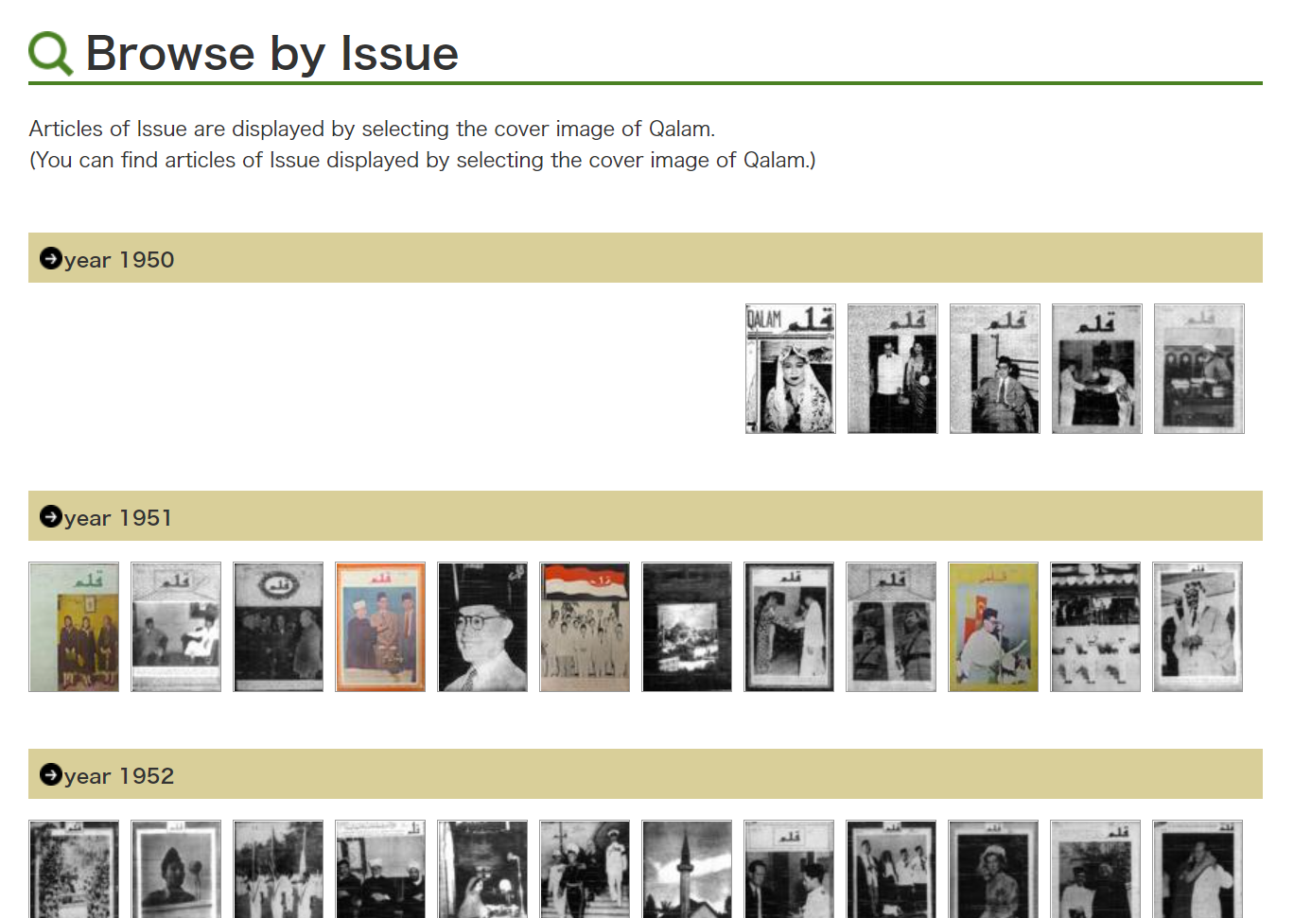
Example Source Object (1)
Dataset of Magazines
Notes:
To describe a digital collection of a magazine, the title or publication information of the magazines are obviously informative.

Slide 16
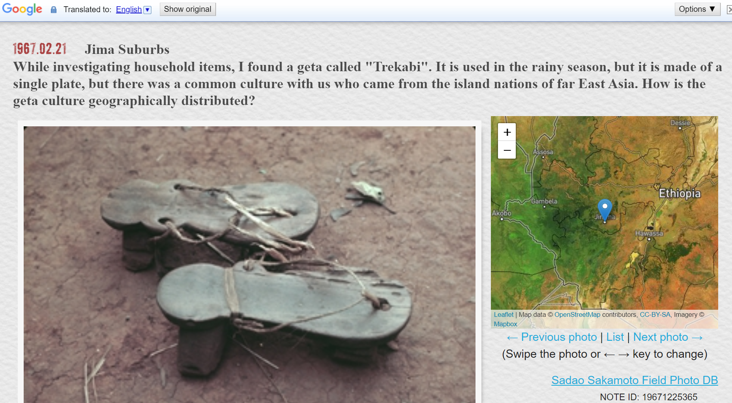
Example Source Object (2)
Dataset of Fieldnotes
Notes:
To describe a digital collection of a fieldnote, not only the information of the fieldnote, spatial information of the investigated area is essential. To describe a gazetteer, which is a collection of geographical names, sometimes it has a source book, sometimes not. If not, geographical features can be the Source Objects.

Slide 17
Metadata Model
is about
Dataset
Source
Object
describes
describes
Inventory Entry
Notes:
Thus, in humanities, information of the existent collections or such archival contexts of the datasets is important. So, the original title, temporal and spatial coverage, or type of the Source Object are recorded. If the dataset has a complicated structure, the roughest list is the target of the cataloguing process.

Slide 18
Metadata Model
is about
Dataset
Source
Object
Collect
describes
consists of
Source
Object
Entry
describes
Inventory Entry
Data
describes
describes
Data
Entry
describes
Collect
Notes:
Through the investigation and discussion, we designed the model again and again, with keeping the model simple as much as possible, and, after all, we get the model shown. Then, attributes such as titles, contributors, or languages are listed for each element in this model.
## Description of each record of the Source Object, which is called data here, can be written in a different language from Source Object. Building this model was important because we have to distinguish Source Object, Data, and Inventory Entry from the Dataset.

Slide 19
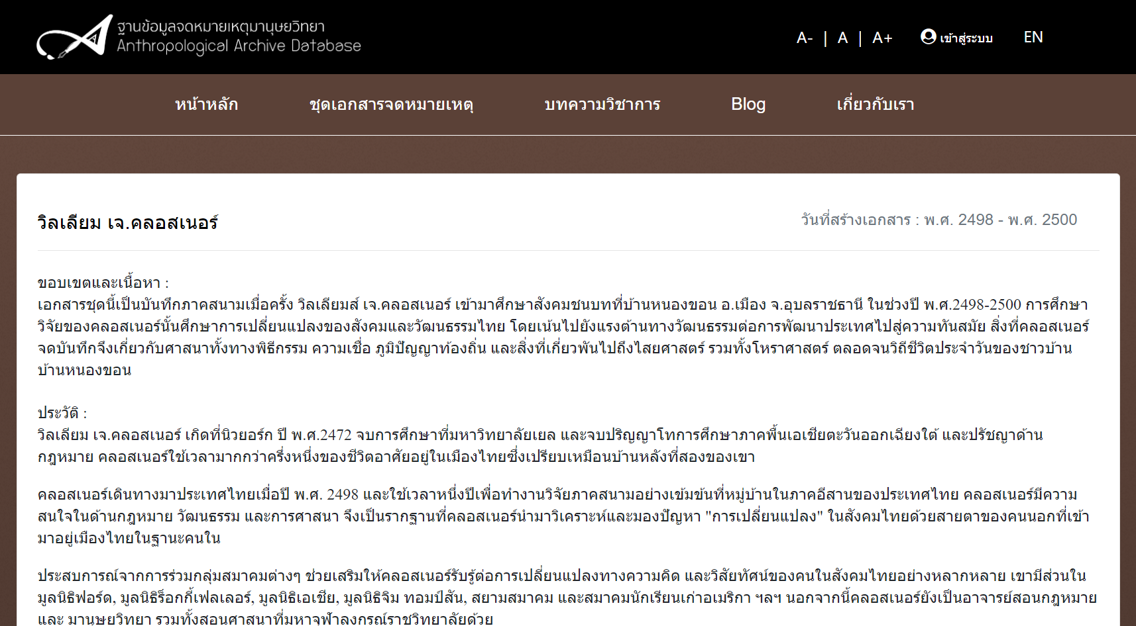
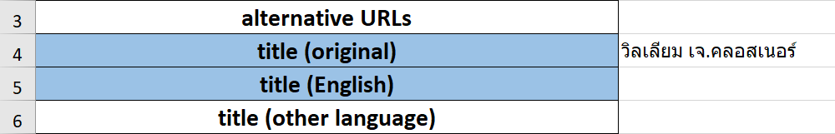
Example of a cataloguing process
วิลเลียม เจ.คลอสเนอร์
(Dataset title in Thai language)
Notes:
From this slide, I’ll explain an example of the cataloguing process. The image is a screenshot of the anthropological database in Thailand. We recorded the dataset title in the Thai language.

Slide 20
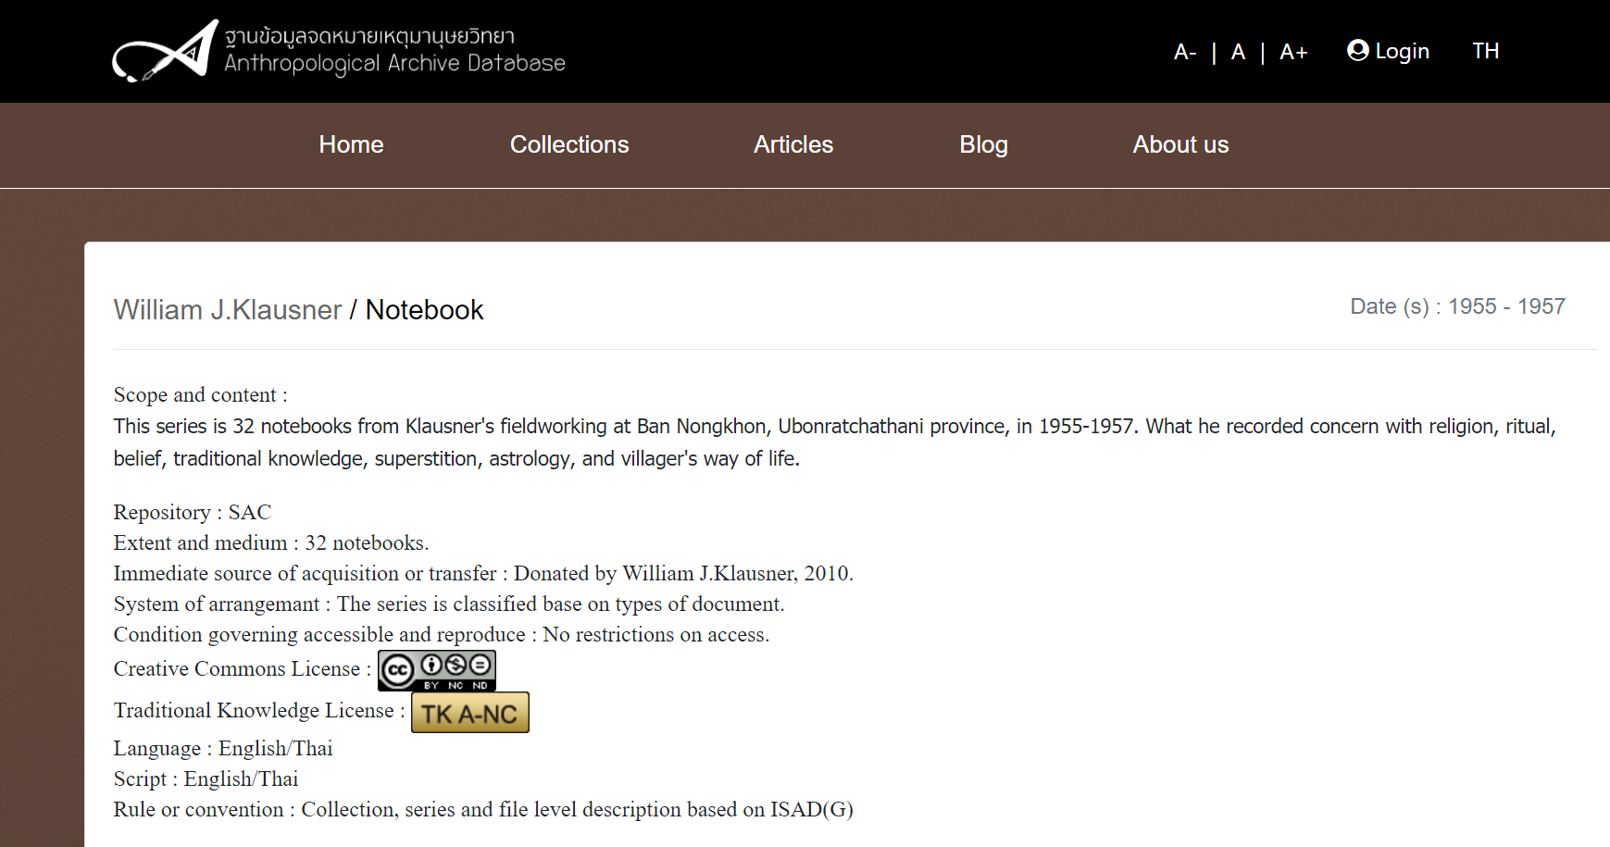
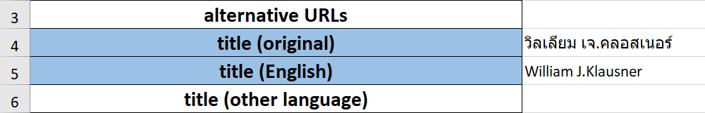
Example of a cataloguing process
William J.Klausner
(Dataset title in English)
Notes:
On the translated page, they provide the title in English also. We recorded it too.

Slide 21
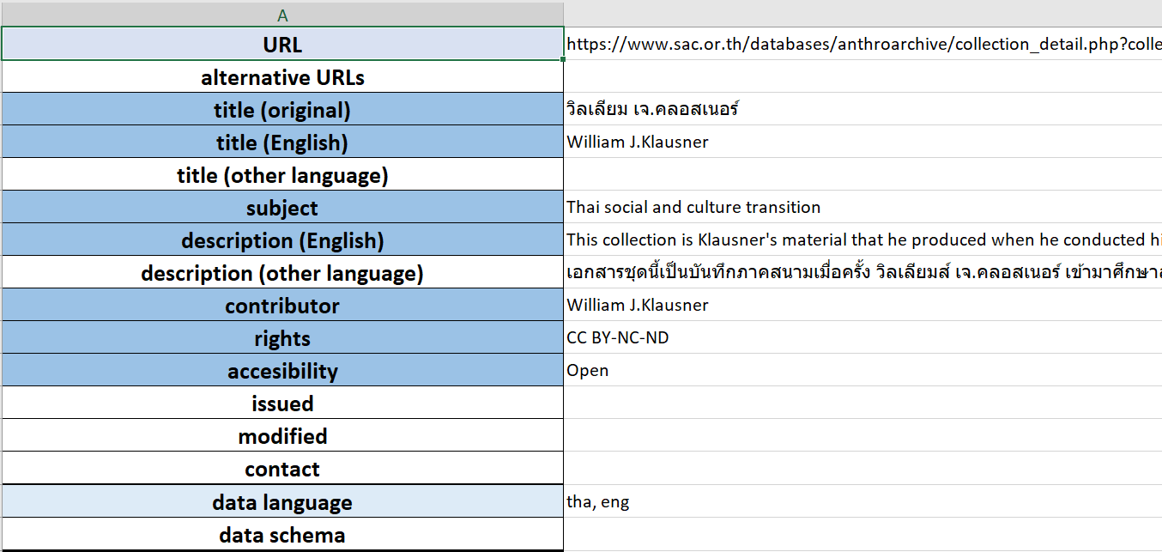
Example of a cataloguing process
Notes:
Some information pieces are missing on their website, so we left them blank or asked the hosting institute to fill them if the institute was in our collaboration network.

Slide 22
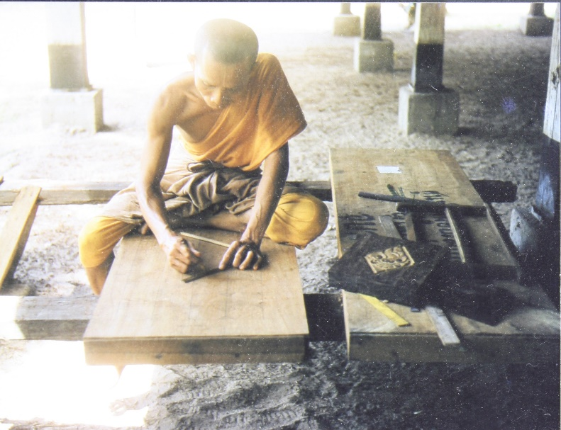
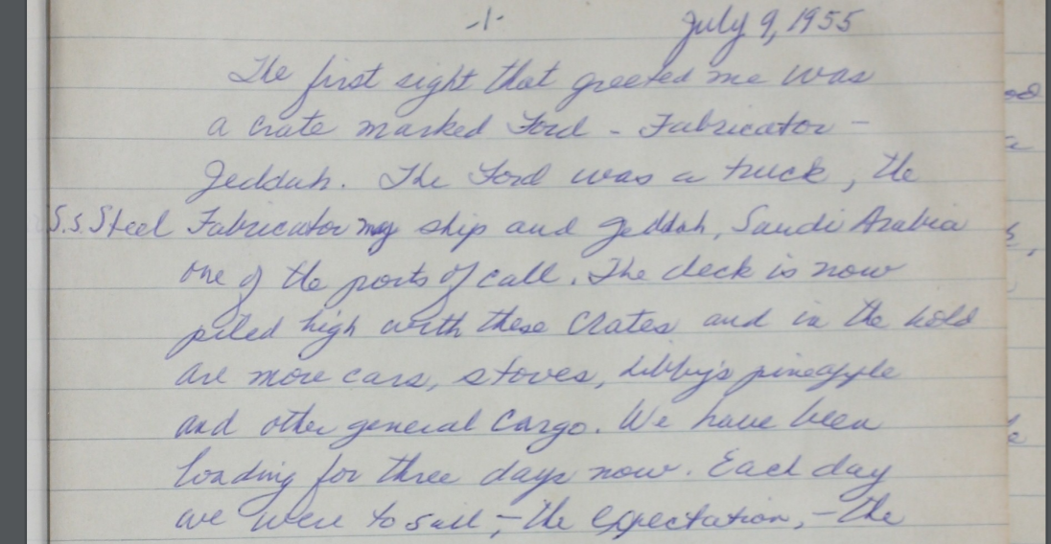
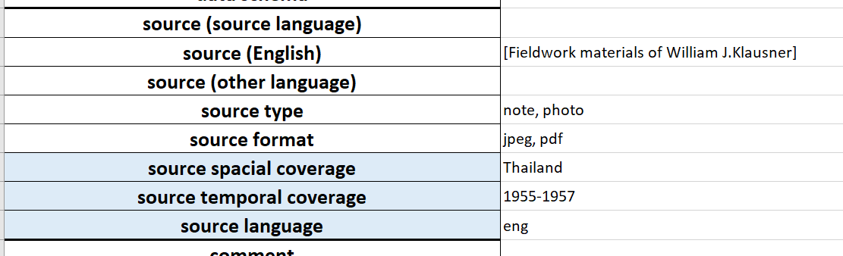
Example of a cataloguing process
Notes:
Attributes are separated corresponding to the metadata model. Here, we recorded spatial and temporal coverage of the fieldwork materials. The language of the Source Object is English, as the fieldnotes are written in English.
## Source Object of the digital collection of fieldwork materials is the fieldwork materials. The title of this Dataset is just the name of the researcher, but we can recognize the set of the materials, which is the target of description and digital publication.

Slide 23
International collaboration
across languages
Source
Object
Thai
Japanese
Malay
other
Inventory
Entry
Thai+
other
Japanese +other
Malay +other
another +other
Collect and Aggregate metadata into
the RsDA Inventory Database
RsDA Inventory
Notes:
In terms of language diversity, each website often has information in more than one language added to the Source Object language. Our RsDA Inventory database records title and description information at least in English. Metadata in English helps users to retrieve and understand datasets across languages.

Slide 24
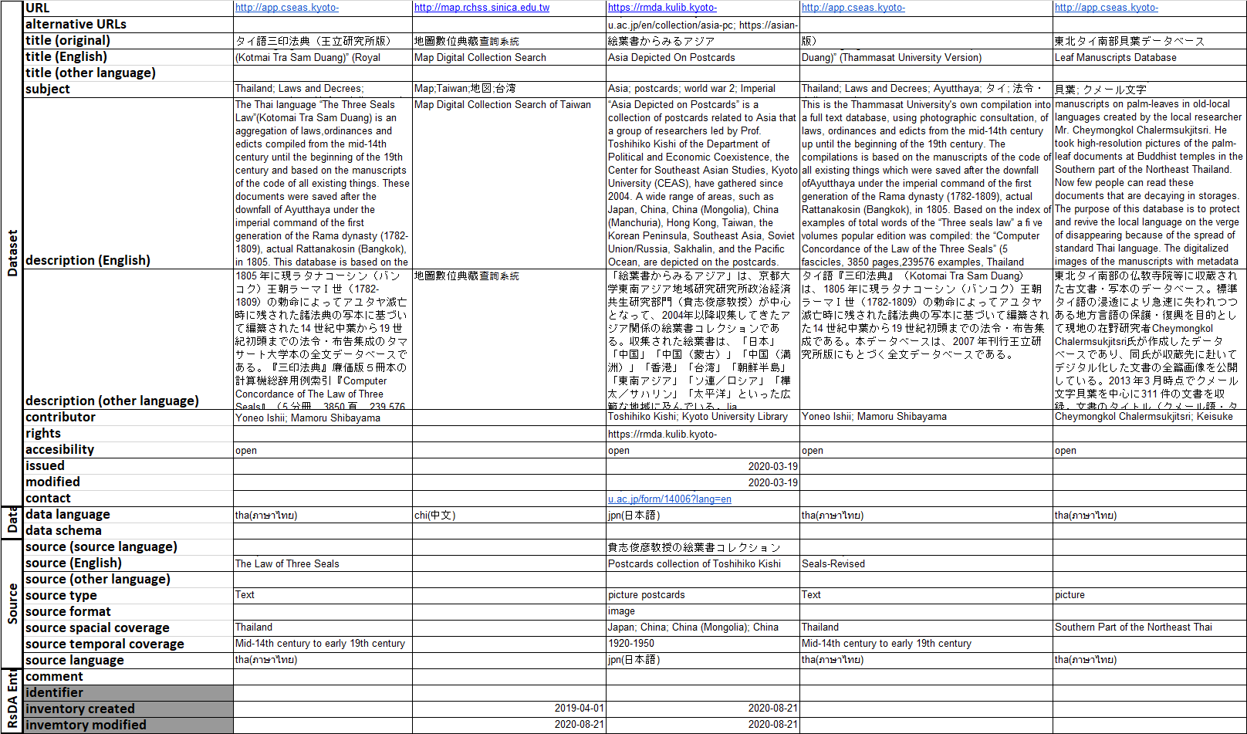
Inventory Database as a spreadsheet
Dataset
Each dataset
Each dataset
Data
Source
Object
Inventory
Entry
Notes:
As a result, the metadata of each database makes up one record of our Inventory Database. We collect and hold those records as a spreadsheet.

Slide 25
Example of RsDA Database
Notes:
To search this inventory database efficiently, we are building a search interface. In this demo, we filtered datasets with a keyword “map”, and from the results, we can find original dataset. Time slider for temporal information and map interface for spatial information are to be implemented.

Slide 26
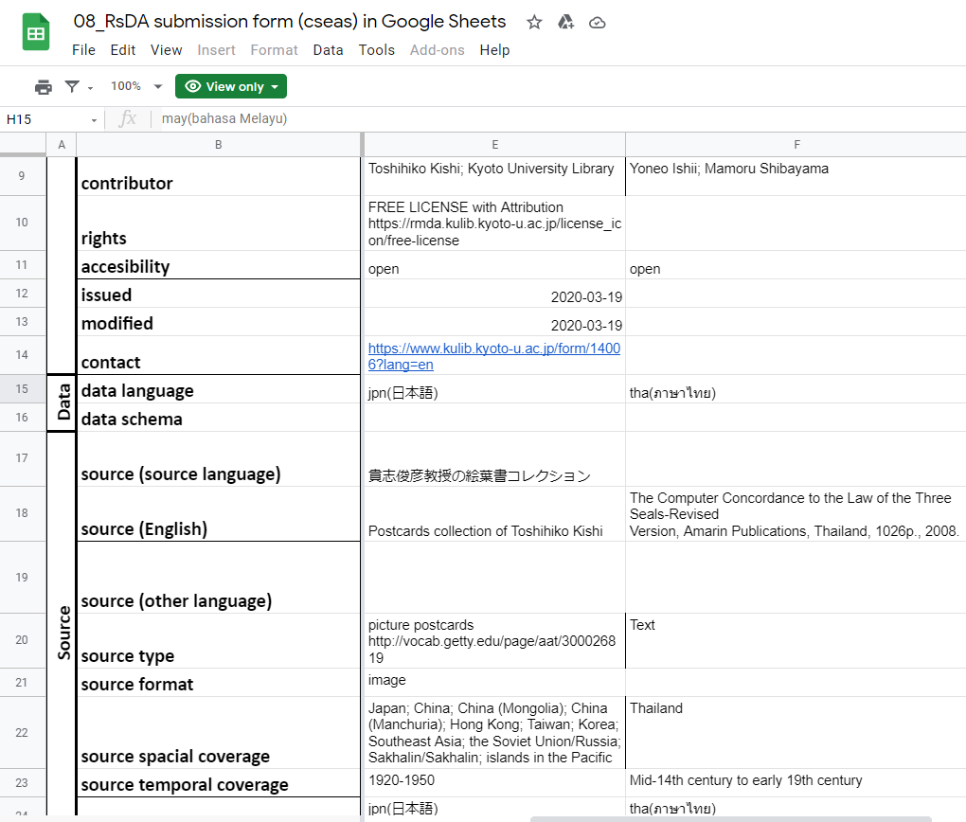
Light-weight design of the system
Google Sheets
for our collaboration
Single JSON file
and Vue.js for
the search interface
For integrating data,
we use some scripts.
But we don’t have to
keep heavy web service
stack.
Notes:
We use Google sheets to make and share inventory entries.Following the metadata model, we split attributes corresponding to each entity in the model, but the model was so simple that we could describe datasets information in the table structure.
To implement the search interface I mentioned in the previous slide, we used Vue.js for the single page application. That page calls a single JSON file, into which we integrated submitted data.
We don’t have and need to maintain any heavy backend system.

Slide 27
Conclusion
Establishing an international collaboration framework (RsDA)
  Researchers, librarians, and archivists
Building the inventory database to share research data assets in East and Southeast Asia
  Simplicity: metadata model, database technology
  Diversity: multi-linguality, user interface requirements
Offering the forum for discussing long-term use and preservation of data
Notes:
As a summary, in this project, we have been developing a platform for researchers, librarians and archivists to share knowledge and data and to enhance the longevity of research data assets across boundaries and languages in Southeast and East Asia. The inventory database which is a core product of this project is designed based on the two basic concepts – Simplicity and Diversity. And, a crucial aspect of this project is to build a network of people and their institutions in the region.

Slide 28
Challenges for the Future
Humanities’ research data are difficult to manage: small, segmented, researcher dependent, volatile
Building sustainable system to preserve and salvage research data assets
  Lightweight platform
  Community for maintenance
Expanding collaborative framework in the region
We welcome your participation to RsDA!
Notes:
In the reality we have faced several challenging issues in this project. Research data databases in the humanities are in general small, fragmented and researcher dependent. For example, once a researcher who developed a database retires the database is easily lost. It is not an easy task for libraries and archives at universities to keep the research data databases alive over time. We have learned that light-weight tools easy to use and community building for the future are crucial. We are willing to expand our collaboration network.
Last but not least, If you have interests in joining the RsDA project, please feel free to contact us.
Thank you very much for your attention.

Slide 29
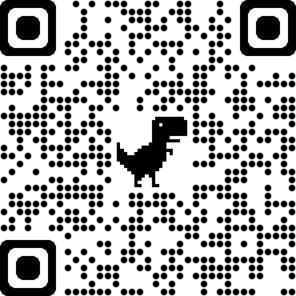
http://rsda.mydatabase.jp/

